Slide 1
Medical Device Proposal Veronica Chan
Springboard Data Science Intensive Capstone Project
April 10, 2024

Slide 2

Problem Statement
TG Medical (USA) Inc. is a worldwide leader in manufacturing and specialization in disposable gloves.
Will be proposing a new medical device to add on to the product list and predict whether it will generate profit for the company.

Slide 3
Data Information
Medicare Durable Medical Equipment, Devices & Supplies dataset
Source: Data.CMS.gov
File format: csv
Data acquired for 2021
Number of records: 40267
Number of fields: 18
Each record contains a medical device with various geographical and payment features

Slide 4

Data Analysis

Slide 5
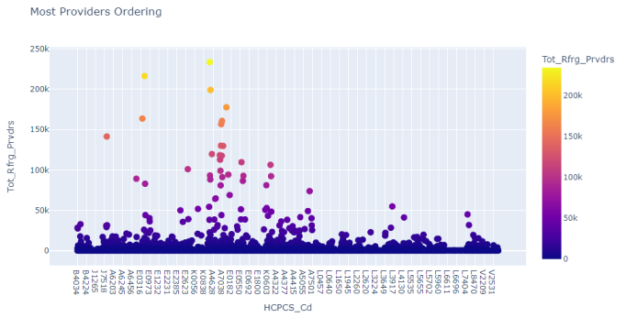
The blood glucose test/reagent strips has the most referring providers (233762 providers) meaning the most providers are ordering this item.

Slide 6
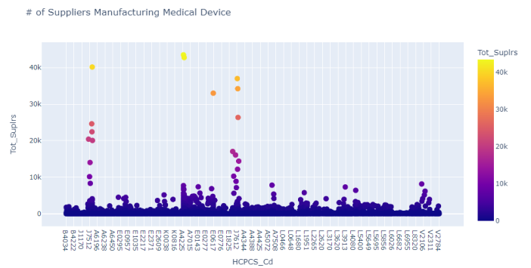
The blood glucose test/reagent strips also have the most suppliers manufacturing it.

Slide 7
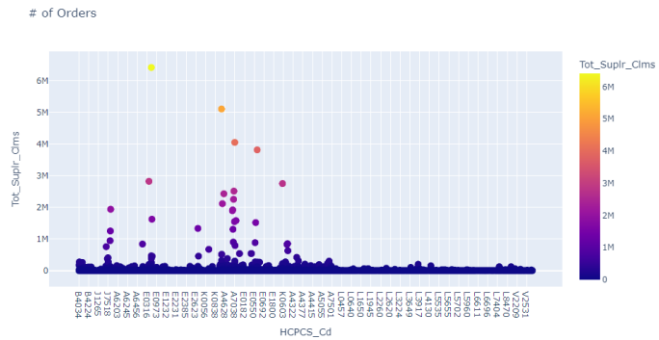
The blood glucose test/reagent strip is the 2nd most ordered item, the most ordered item is the oxygen concentrator.

Slide 8
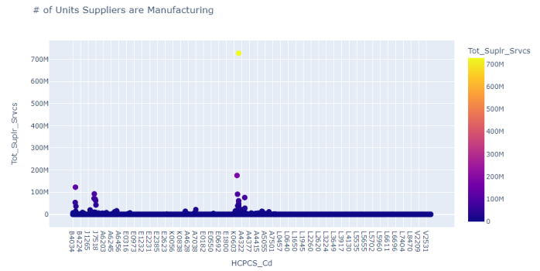
Only under 200M units of the blood glucose test/reagent strips were manufactured, the most manufactured item is the revefenancin inhalation solution.

Slide 9
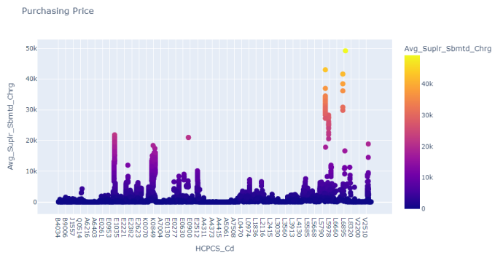
The blood glucose test/reagent strips were being charged on the lower end compared to the rest of the medical devices. The most expensive medical device is the electronic elbow. We also found that the average purchasing price for blood glucose test/reagent strip is $61.44.

Slide 10
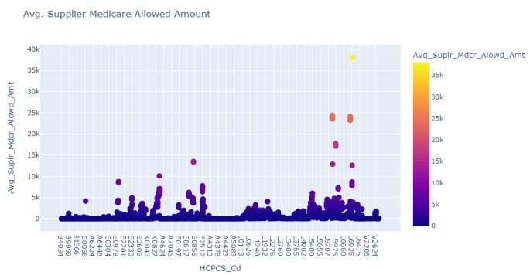
The blood glucose test/reagent strips were being covered by Medicare on the lower end compared to the rest of the medical devices, this makes sense as the blood glucose test/reagent strips do not cost as much as other items. The most covered by Medicare is the electronic elbow which is also the most expensive item. The results are the same for Medicare payment amount and Medicare standardized payment amount, we can assume that these factors are correlated and have the same influence on other features.

Slide 11
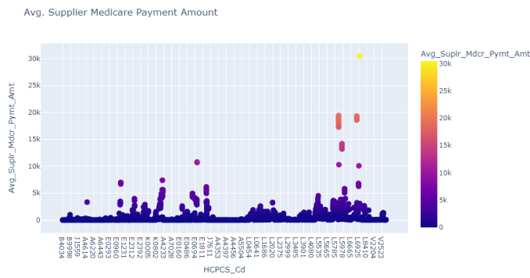

Slide 12


Slide 13
Modeling Steps
Data pre-processing steps:
Label encoding
Dummy features
Modeling
Conducted several models: linear regression, gradient boosting regression, and random forest regression
Best Estimators
Top four features
Linear Regression Model
Random Forest Model
Cross Validation
Model accuracy score
Finding feature coefficients
Choosing the best-performing algorithm

Slide 14

Best Estimators:
Avg_Suplr_Mdcr_Pymt_Amt: 160.274626
Puerto Rico: -1.384814
Avg_Suplr_Mdcr_Alowd_Amt: -33.55931
Avg_Suplr_Mdcr_Stdzd_Amt: -146.573691

Slide 15
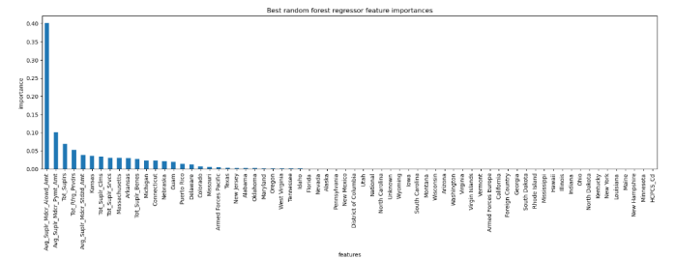
The dominant top four features in common with the linear model are: • Avg_Suplr_Mdcr_Allowd_Amt • Avg_Suply_Mdcr_Pymt_Amt • Tot_Suplrs • Tot_Rfrg_Prvdrs

Slide 16
For the Linear Regression model: • The mean cross-validated Mean Absolute Error (MAE) is approximately 3.42, with a standard deviation of approximately 1.06. • The MAE calculated directly on the test set using the best estimator from grid search is approximately 3.48. For the Random Forest mode: • The mean cross-validated MAE is approximately 4.08, with a standard deviation of approximately 0.51. • The MAE calculated directly on the test set using the best estimator from grid search is approximately 3.31.

Slide 17
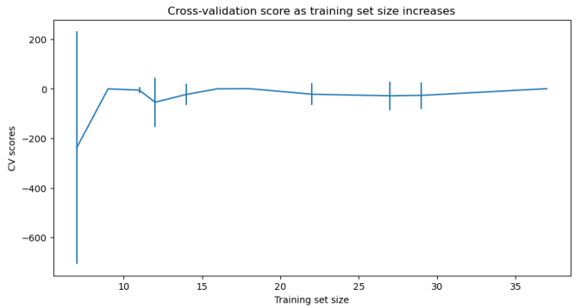
There is an initial rapid improvement in model scores but levels off which indicates that adding more data does not significantly import model performance beyond a certain point.

Slide 18
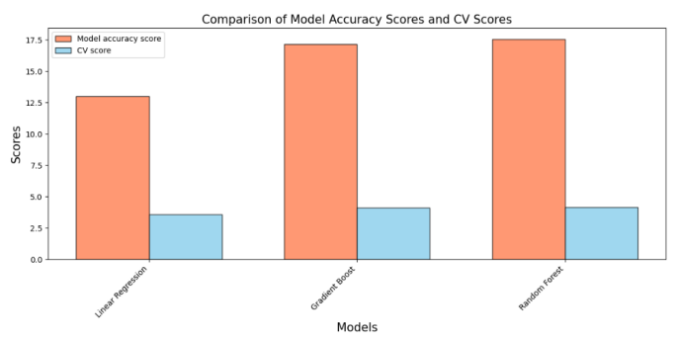
Linear Regression appears to perform the best among the three algorithms as it has the lowest scores.

Slide 19
Conclusion Future Work
Linear Regression model is the best model for predicting whether the blood glucose test/reagent strip will generate profit for the company, it performs slightly better than Gradient Boosting and Random Forest models.
A lot of features are not important and have no impact on the target variable.
Further analysis, such as examining additional evaluation metrics, tuning hyperparameters, or exploring different algorithms to help make a better decision on the best-performing algorithm.
Integrating data from the company for more accurate predictions.

Slide 20
Thank You
Veronica Chan
Email: veronica.chan143@yahoo.com
LinkedIn: https://www.linkedin.com/in/veronica-chan-4712a21b2
GitHub Repo: https://github.com/vchan022/Capstone-2-Medical-Device-Proposal

